Slide 1

Intro to Game Development
Behram Khan

Slide 2
Course Prerequisite
Knowledged of OOP’s
Willingness to learn

Slide 3
NOTE!!
This is an intensive course with project based learning!
Students must bring a laptop to both theory and lab classes.
Attendance will be at 8:15 AM.

Slide 4
What are games?

Slide 5
Games
Games are interactive systems designed to provide players with challenges, goals, and feedback.
A game usually has rules
A player or multiple players
A goal or win/lose condition
Some form of interaction that changes the game state.
Unlike movies or books, games respond to player input and evolve over time.
Video game : A game played by electronically manipulating images produced by a
computer program on a monitor or other display.
Notes:
STR: Store a value to memory.
ADD: Add two values.
SUB: Subtract one value from another.
MOV: Move data from one location to another.

Slide 6
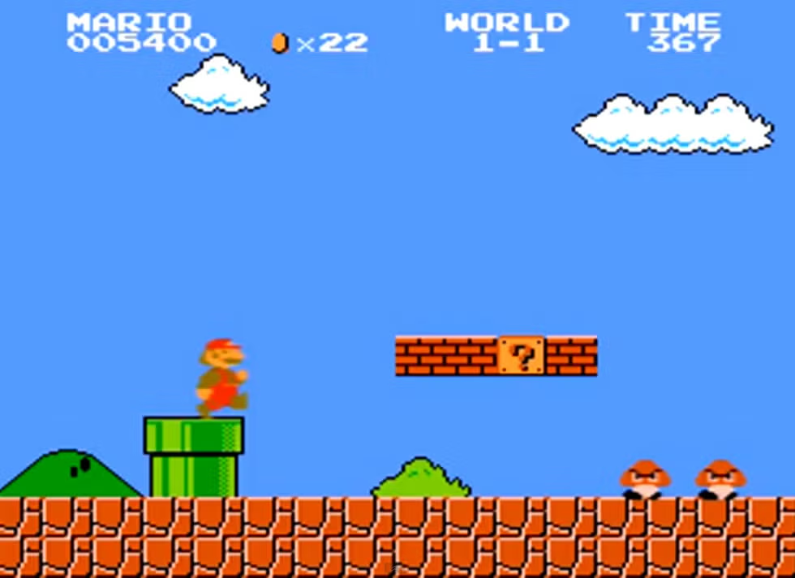
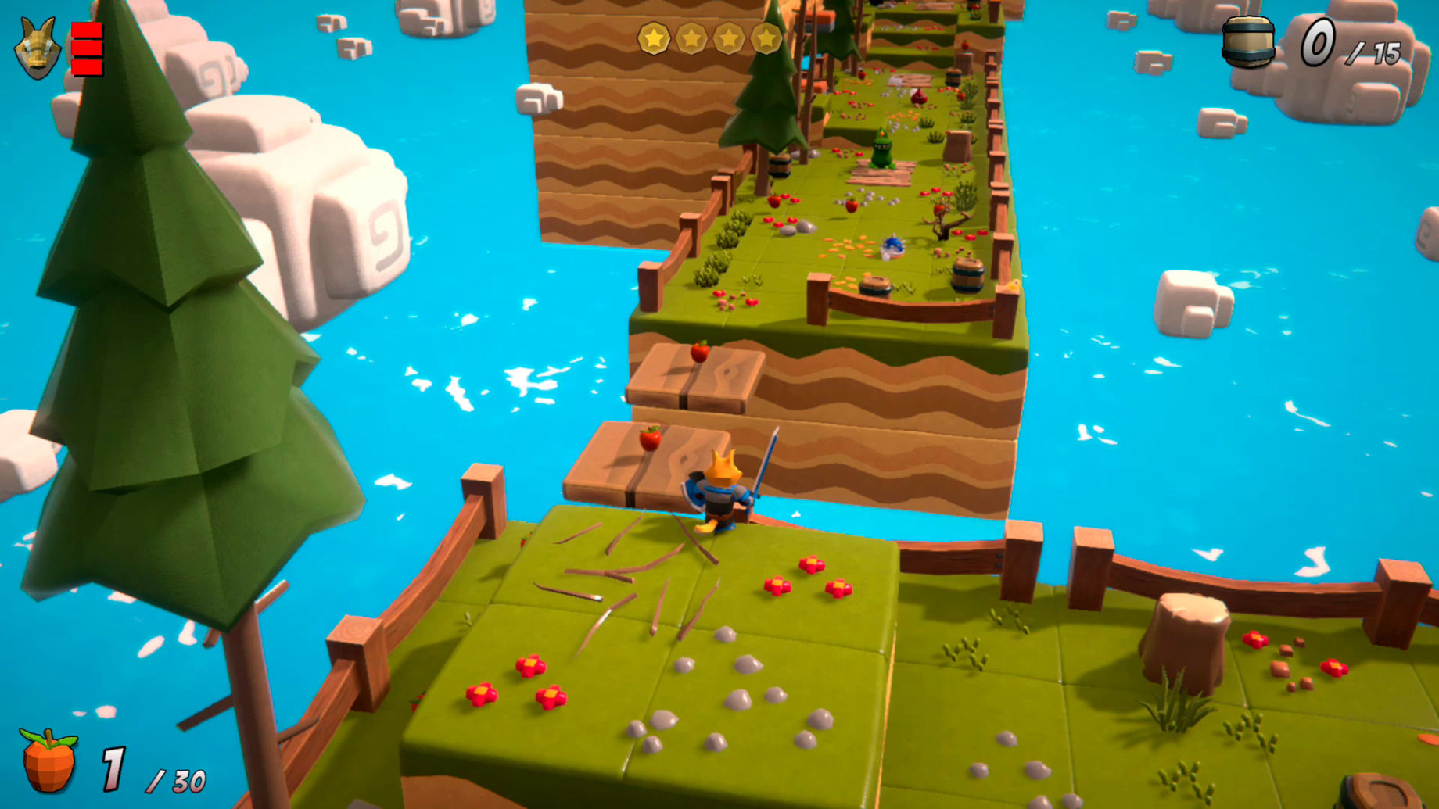
Types of Games
Platformer
Mario
Rise of Fox Hero
Notes:
STR: Store a value to memory.
ADD: Add two values.
SUB: Subtract one value from another.
MOV: Move data from one location to another.

Slide 7
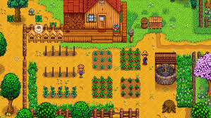
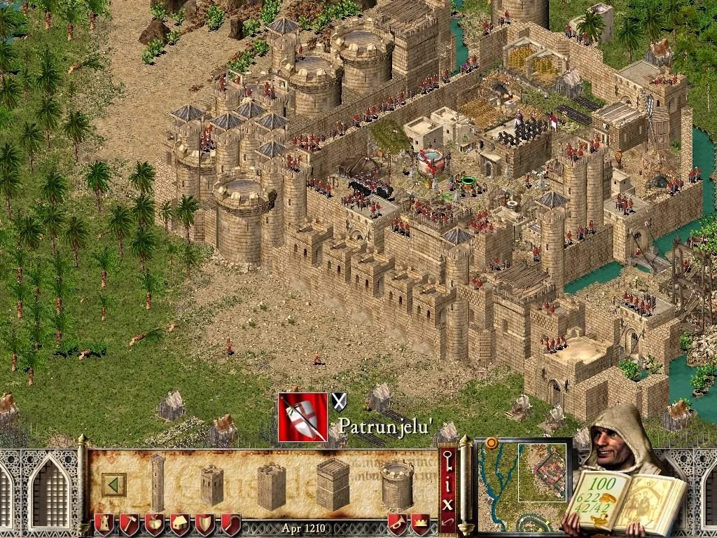
Types of Games
Top-Down
Stardew Valley
Stronghold Crusader
Notes:
STR: Store a value to memory.
ADD: Add two values.
SUB: Subtract one value from another.
MOV: Move data from one location to another.

Slide 8
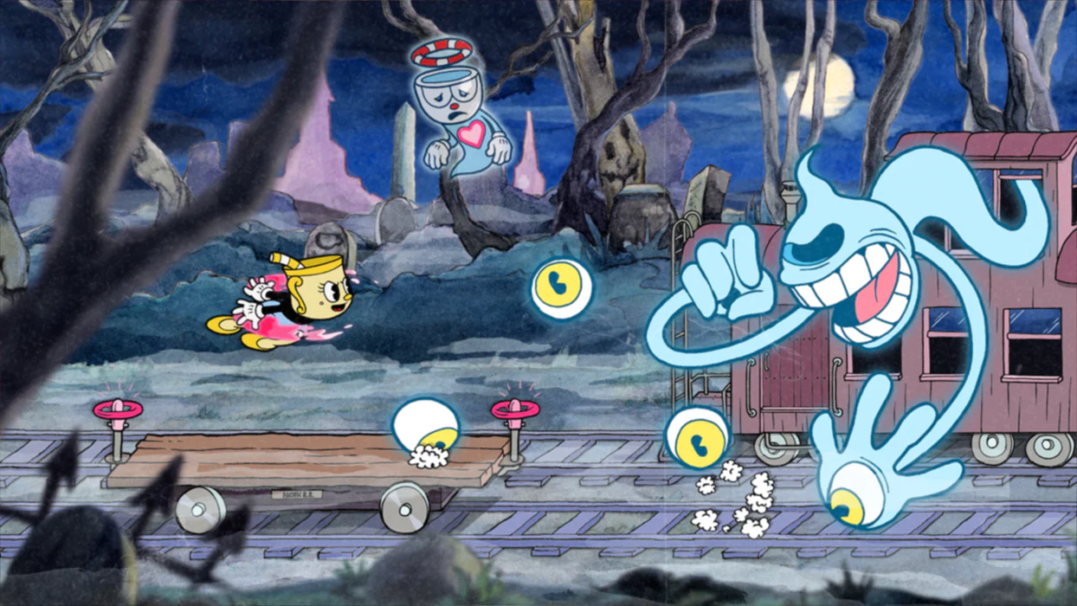
Types of Games
Side-Scroller : More focused on side scrolling than platforms
Cuphead
Notes:
STR: Store a value to memory.
ADD: Add two values.
SUB: Subtract one value from another.
MOV: Move data from one location to another.

Slide 9
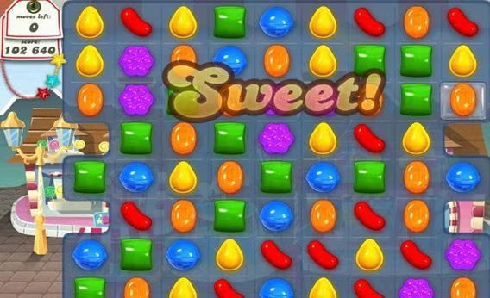
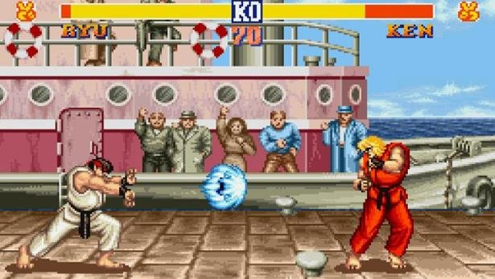
Types of Games
Puzzle
Candy Crush
Street Fighter
Notes:
STR: Store a value to memory.
ADD: Add two values.
SUB: Subtract one value from another.
MOV: Move data from one location to another.

Slide 10
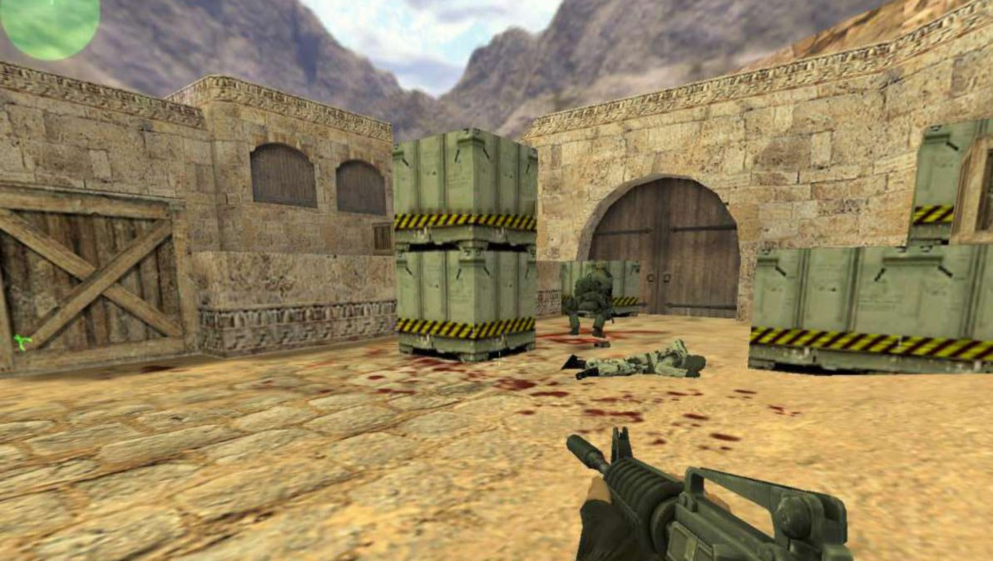
Types of Games
First Person Shooter (3D)
Counter Strike 1.6
Notes:
STR: Store a value to memory.
ADD: Add two values.
SUB: Subtract one value from another.
MOV: Move data from one location to another.

Slide 11
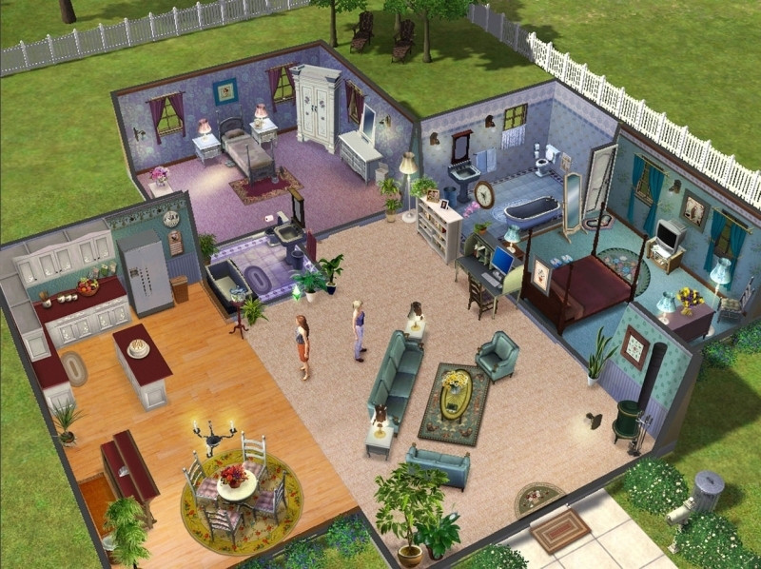

Types of Games
Simulations
SIMS
Doctor Simulator
Notes:
STR: Store a value to memory.
ADD: Add two values.
SUB: Subtract one value from another.
MOV: Move data from one location to another.

Slide 12
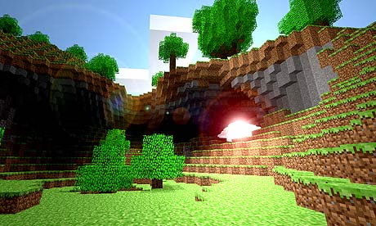
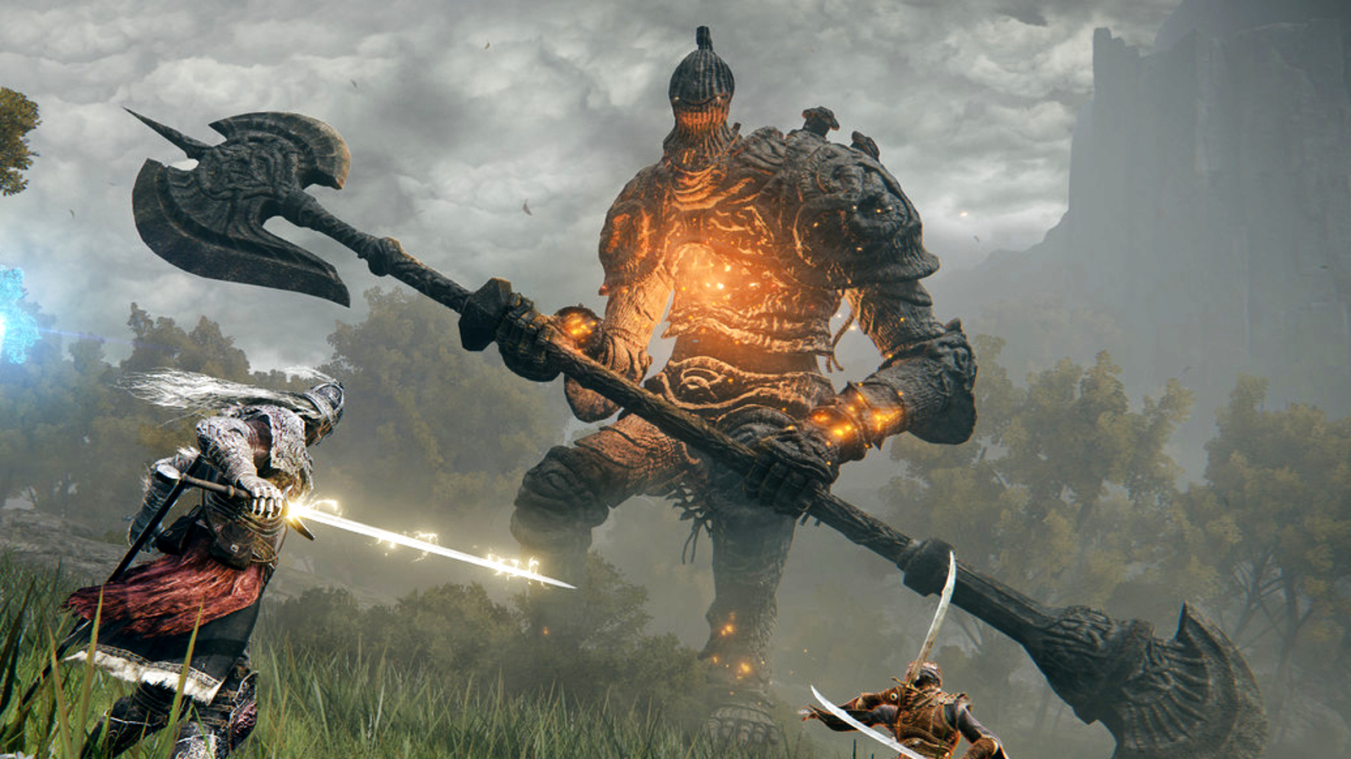
Types of Games
Open World
Minecraft
Elden Ring
Notes:
STR: Store a value to memory.
ADD: Add two values.
SUB: Subtract one value from another.
MOV: Move data from one location to another.

Slide 13

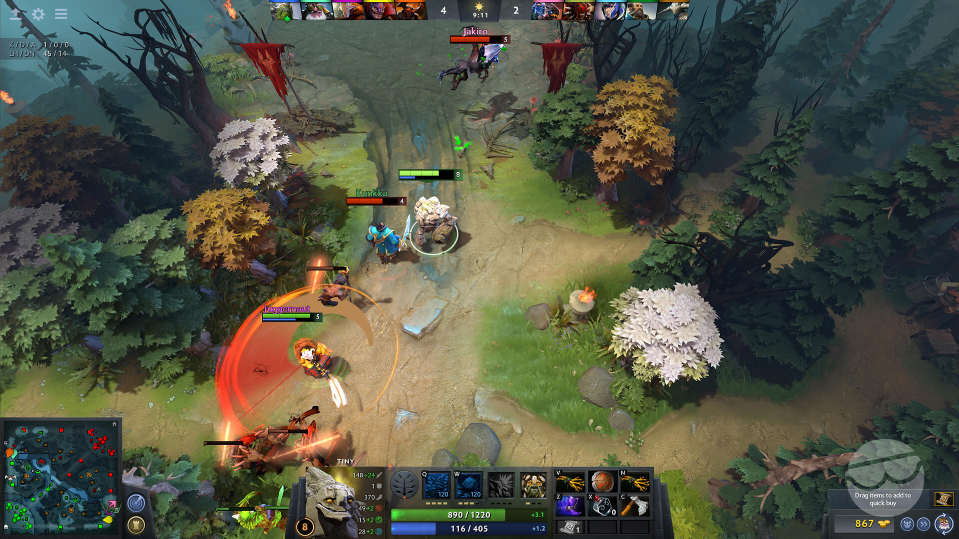
Types of Games
Single player : Played alone. Multiplayer : Player with multiple people on same screen or online.
DOTA 2
Notes:
STR: Store a value to memory.
ADD: Add two values.
SUB: Subtract one value from another.
MOV: Move data from one location to another.

Slide 14
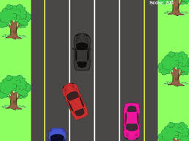
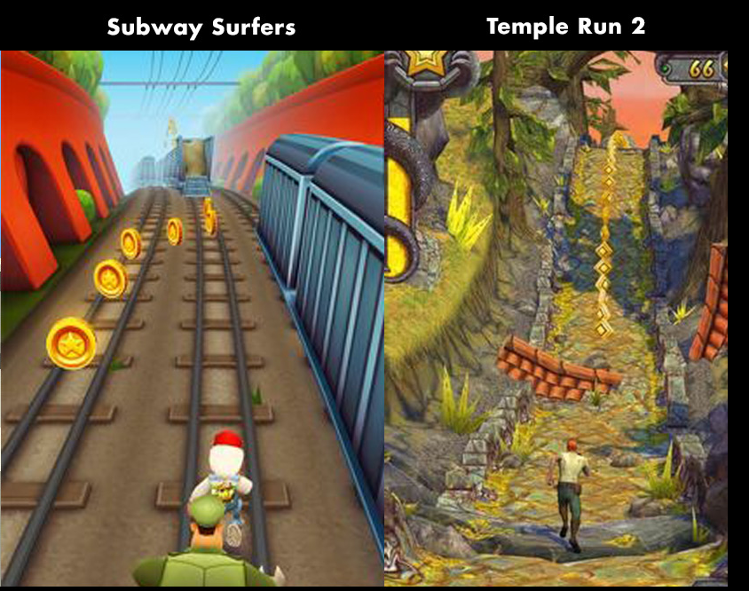
Types of Games
Endless runner
Notes:
STR: Store a value to memory.
ADD: Add two values.
SUB: Subtract one value from another.
MOV: Move data from one location to another.

Slide 15
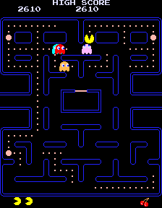
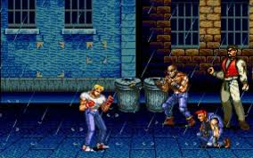
Types of Games
Arcade
Pac Man
Street of Rage
Notes:
STR: Store a value to memory.
ADD: Add two values.
SUB: Subtract one value from another.
MOV: Move data from one location to another.

Slide 16
Types of Games
Strategy games: Real time and Turn-based
Role Playing Games: Action and Turn-Based
Educational Games : Duolingo
Hybrid : Fortnite (Building + shooter + social)
And many more…
Notes:
STR: Store a value to memory.
ADD: Add two values.
SUB: Subtract one value from another.
MOV: Move data from one location to another.

Slide 17
What is Game Development?

Slide 18
Game development
The process of designing, creating, testing, and releasing a game. It combines creativity and technical skills. Game development is not just programming; it involves art, design, sound, storytelling, and production planning.
Notes:
STR: Store a value to memory.
ADD: Add two values.
SUB: Subtract one value from another.
MOV: Move data from one location to another.

Slide 19
Fields in Game Development
Game Designer
Designs gameplay mechanics and rules
Defines player goals and challenges
Focuses on fun, balance, and player experience
Narrative and overall game experience
Game Programmer / Developer
Writes code that makes the game work
Implements gameplay, AI, physics, animations ,and systems
Fixes bugs and optimizes performance
Notes:
STR: Store a value to memory.
ADD: Add two values.
SUB: Subtract one value from another.
MOV: Move data from one location to another.

Slide 20
Fields in Game Development
Game Artist
Creates characters, environments, and props
Designs textures, materials, and visuals
Defines the overall visual style of the game
3D or 2D
Animator
Creates character and object animations
Rigging
Works on movement, combat, and interactions
Makes the game feel alive and responsive
Notes:
STR: Store a value to memory.
ADD: Add two values.
SUB: Subtract one value from another.
MOV: Move data from one location to another.

Slide 21
Fields in Game Development
UI / UX Designer
Designs menus, HUDs, and screens
Improves usability and player flow
Ensures the game is easy to understand and play
Level Designer
Designs levels, maps, and environments
Places enemies, items, and objectives
Balances difficulty and pacing
Notes:
STR: Store a value to memory.
ADD: Add two values.
SUB: Subtract one value from another.
MOV: Move data from one location to another.

Slide 22
Fields in Game Development
Music Composer
Composes background music and themes
Sets mood and emotional tone
Adapts music to gameplay situations
Sound Designer
Creates sound effects (footsteps, explosions, UI sounds)
Adds audio feedback for player actions
Enhances immersion through sound
Notes:
STR: Store a value to memory.
ADD: Add two values.
SUB: Subtract one value from another.
MOV: Move data from one location to another.

Slide 23
Fields in Game Development
Producer / Project Manager
Plans schedules and milestones
Coordinates between team members
Ensures the project stays on track
Quality Assurance (QA) / Tester
Tests the game for bugs and issues
Reports problems clearly to the team
Helps improve stability and polish
Notes:
STR: Store a value to memory.
ADD: Add two values.
SUB: Subtract one value from another.
MOV: Move data from one location to another.

Slide 24
Stages of Game Development

Slide 25
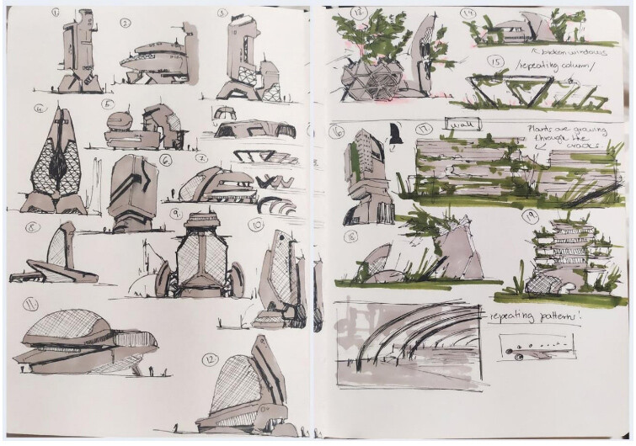
Stages in Game Development
Pre-Production
Game idea and core concept
Game Design Document (GDD)
Concept art and references
Planning scope, tools, and timeline
Notes:
STR: Store a value to memory.
ADD: Add two values.
SUB: Subtract one value from another.
MOV: Move data from one location to another.

Slide 26
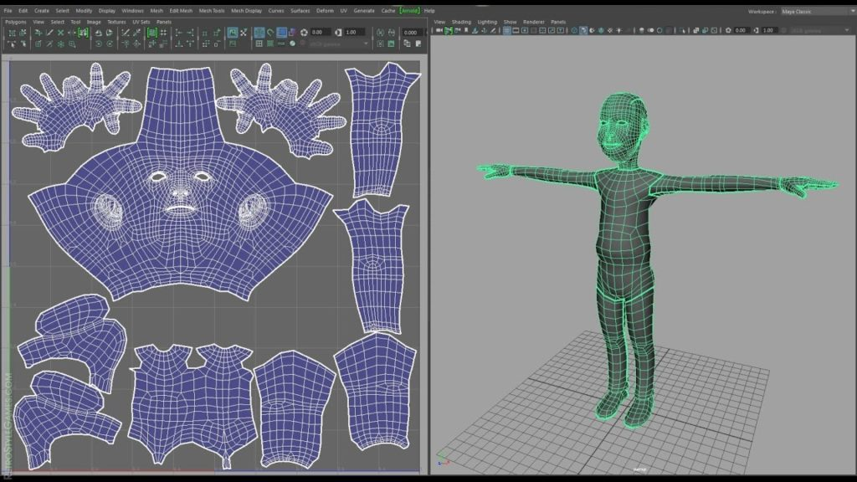
Fields in Game Development
Production
Programming gameplay systems
Creating art, models, and animations
Level design and world building
UI, sound, and core mechanics implementation
Notes:
STR: Store a value to memory.
ADD: Add two values.
SUB: Subtract one value from another.
MOV: Move data from one location to another.

Slide 27
Fields in Game Development
Post-Production
Testing and bug fixing
Performance optimization
Polishing visuals and gameplay
Releasing updates and patches
Notes:
STR: Store a value to memory.
ADD: Add two values.
SUB: Subtract one value from another.
MOV: Move data from one location to another.

Slide 28
What Is a Game Engine?

Slide 29
Game Engine
A software that provides tools and systems to build games efficiently. It handles:
rendering,
physics,
input,
audio,
animation,
AI,
networking,
VFX,
memory management
scripting
Notes:
STR: Store a value to memory.
ADD: Add two values.
SUB: Subtract one value from another.
MOV: Move data from one location to another.

Slide 30
Popular Game Engines
Unity
Uses C# for scripting
Popular for mobile, indie, 2D, and 3D games
Large community and learning resources
Supports many platforms (PC, mobile, console, AR/VR)
Fast prototyping and beginner-friendly
Unreal Engine
Uses C++ and Blueprints (visual scripting)
Known for high-quality graphics
Commonly used in AAA games
Strong tools for lighting, physics, and cinematics
Heavier and more complex than Unity
Godot
Open-source and free
Uses GDScript (Python-like), C#, and C++
Lightweight and easy to run
Great for 2D games and small projects
Smaller community compared to Unity and Unreal
Notes:
STR: Store a value to memory.
ADD: Add two values.
SUB: Subtract one value from another.
MOV: Move data from one location to another.

Slide 31
Basic Game Concepts
Player
The character or entity controlled by the user
Responds to player input (keyboard, mouse, controller)
Has abilities, stats, or goals
Input
How the player interacts with the game
Keyboard, mouse, controller, touch, VR input
Checked repeatedly inside the game loop
NPC (Non-Player Character)
Controlled by the game, not the player
Can be enemies, allies, or neutral characters
Uses AI or scripted behavior
Notes:
STR: Store a value to memory.
ADD: Add two values.
SUB: Subtract one value from another.
MOV: Move data from one location to another.

Slide 32
Basic Game Concepts
Game World
The environment where the game takes place
Includes levels, maps, and objects
Can be 2D or 3D
Game Objects / Entities
Everything inside the game world
Player, NPCs, obstacles, items
Usually built from components
States (Game States)
Different modes of the game
Menu, Playing, Paused, Game Over
Helps control logic flow
Feedback
Tells the player what happened
Visual, audio, or UI-based
Makes the game feel responsive
Notes:
STR: Store a value to memory.
ADD: Add two values.
SUB: Subtract one value from another.
MOV: Move data from one location to another.

Slide 33
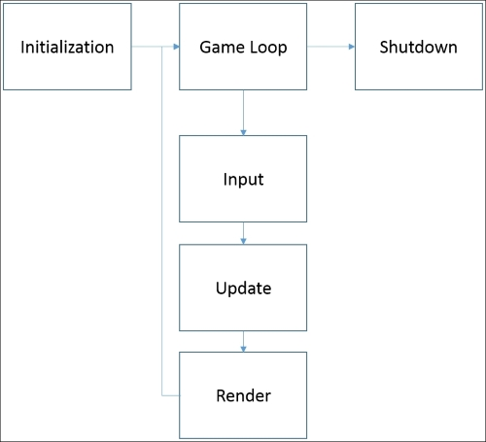
Basic Game Concepts
Game Loop
The core system that keeps the game running
Repeats actions every frame
Handles input, updates logic, and renders visuals
Notes:
STR: Store a value to memory.
ADD: Add two values.
SUB: Subtract one value from another.
MOV: Move data from one location to another.

